Slide 1
Hash Indexing

Slide 2
Hash-Based Indexes
Adaptation of main memory hash tables
Support equality searches
No range searches

Slide 3
Types
Static Hashing
Extensible (Dynamic) Hashing

Slide 4
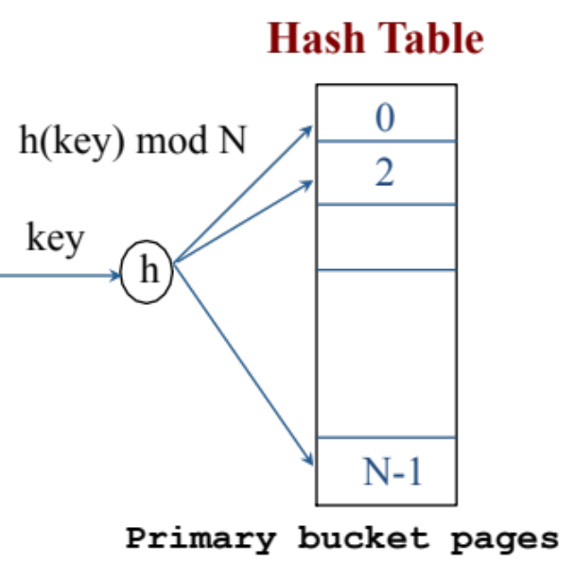
Static Hashing
Hash Table N buckets
Since we talk about databases (disk-based)
  Each bucket will be one disk page
Hashing function h(k) maps key k to one of the buckets
Each bucket is one disk page
Notes:
3

Slide 5
Example Hash Functions
Each bucket is one disk page
Good Hash Function
Expected number of keys/bucket is the same for all buckets
Uniform distribution of keys
If the key k is integer, e.g., 100
  Hash function: k mod N
If the key k is n-byte character string, e.g., “abcd”
  Hash function: add (x1 + x2 + ….. Xn) mod N
Notes:
3

Slide 6
Within A Bucket
Should we keep entries sorted?
  Yes if we care about CPU time
  Makes the insertion and deletion a bit more expensive
Notes:
3

Slide 7
Hash Table: Insertion
We have 4 buckets
Each bucket holds 2 keys
Insert keys a, b, c, and d
INSERT:
h(a) = 1
h(b) = 2
h(c) = 1
h(d) = 0
0
1
2
3
d
a
c
b

Slide 8
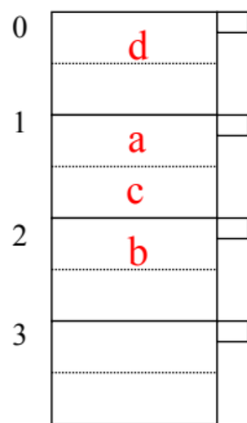
Hash Table: Lookup
Search for key = d
Remember: Only equality search
1- Apply the hash function over d ➔ h(d) = 0
2- Read the disk page of bucket 0
3- Search for key d
- If keys are sorted, then search using Binary search

Slide 9
Hash Table: Insertion with Overflow
Insert key e ➔ h(e) = 1
Create an overflow bucket and insert e
Overflow bucket is another disk block
0
1
2
3
d
a
e
c
b
When Searching
Remember to check the overflow buckets (if exist)

Slide 10
Hash Table: Deletion
Search for the key to be deleted
In case of overflow buckets
  The overflow bucket may no longer be needed
0
1
2
3
d
a
e
c
b

Slide 11
EXAMPLE: Deletion
Assume the following Hash Table
0
1
2
3
a
Delete:
e
f
b
d
c
d
c
e
f
maybe move
“g” up
g

Slide 12
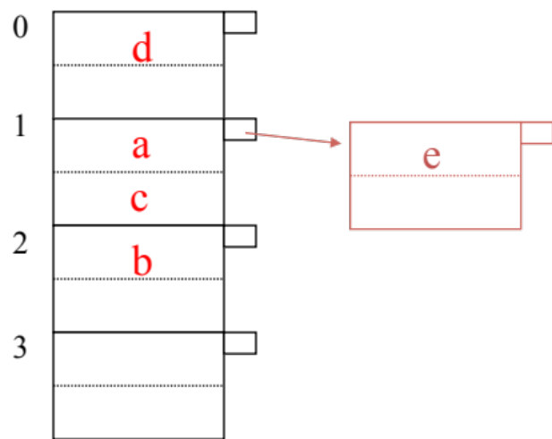
Handling The Growth of Hash Table
In Static Hashing the # primary buckets is fixed
If there are many keys, key distribution is bad
  Use overflow buckets
Bad News
  The chain of overflow buckets may get large
  Search time become slow
Solution ➔ Dynamic Hashing

Slide 13
Dynamic Hashing
The number of primary buckets is not fixed and it can grow
Our focus
Extensible Hashing
Others …

Slide 14
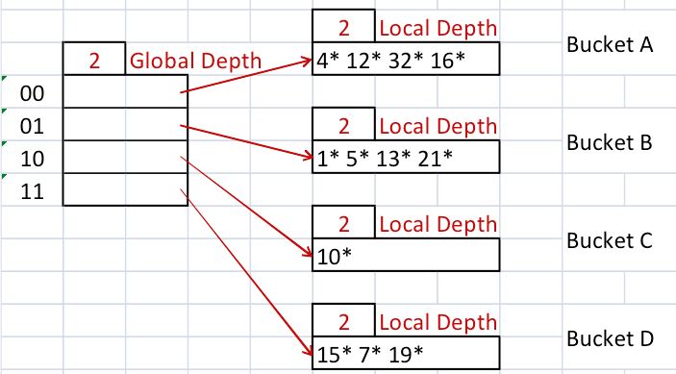
Extensible Hash Index
What to do when bucket (primary page) becomes full.
Main Idea of Extensible Hashing
  Use a level of in-direction (array of pointers pointing to the hash buckets)
  Use directory of pointers to buckets instead of buckets
  double # of buckets by doubling the directory
  split just the bucket that overflowed
Notes:
5

Slide 15
Extensible Hash Index: Terminology
Global depth: # of bits to know
the bucket
Local depth: used at insertion time to know if we need to double the directory size
Buckets
Directory
For a given key k ➔ convert to its bits (0s and 1s)
Notes:
5

Slide 16
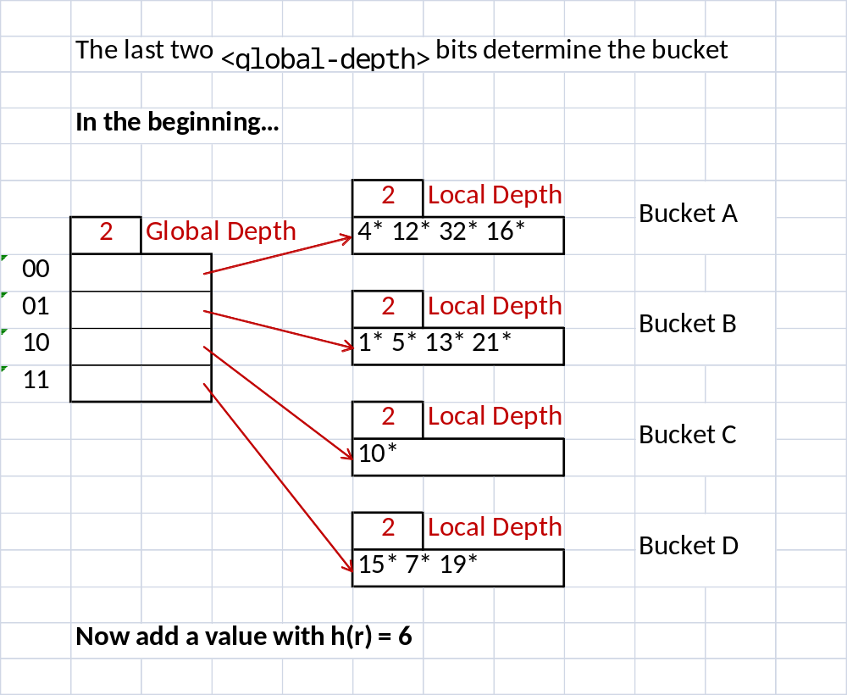
Extensible Hashing: Example
Directory uses 2 bits (the right-most ones) ➔ 4 entries
Directory size = 4
Each bucket holds at most 4 entries
How did we insert values
12, 10, 21?

Slide 17
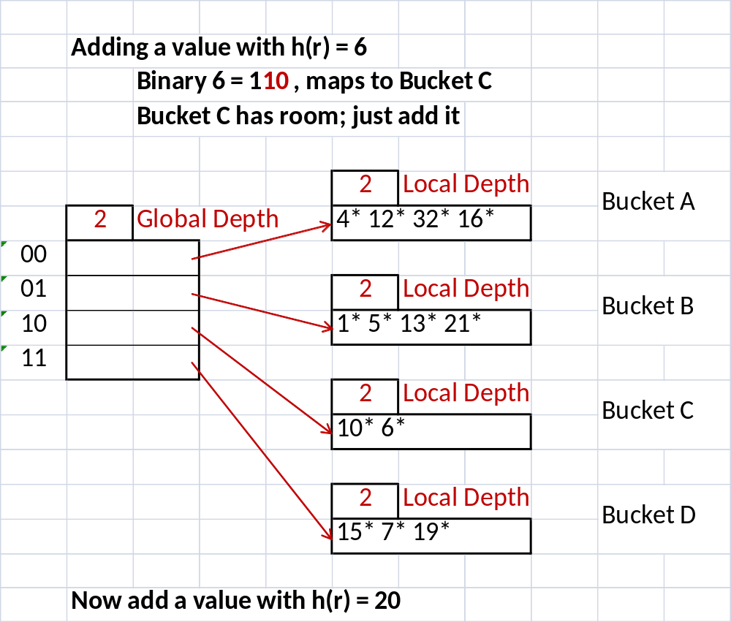
Inserting Key 6
Since global depth = 2, we used only 2 most-right bits

Slide 18
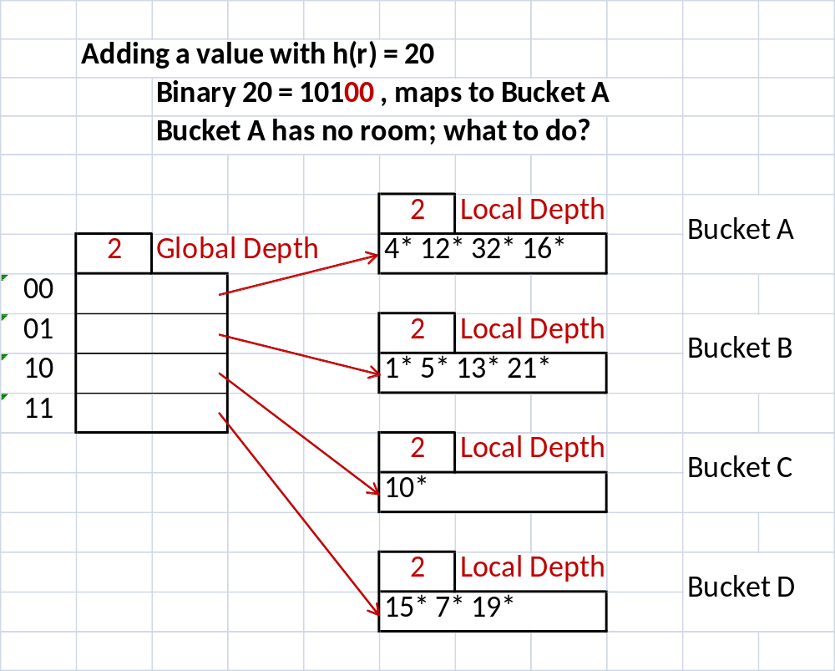
Inserting Key 20
Since global depth = 2, we used only 2 most-right bits
Bucket A is full:
-If local depth = global depth ➔ double the size

Slide 19
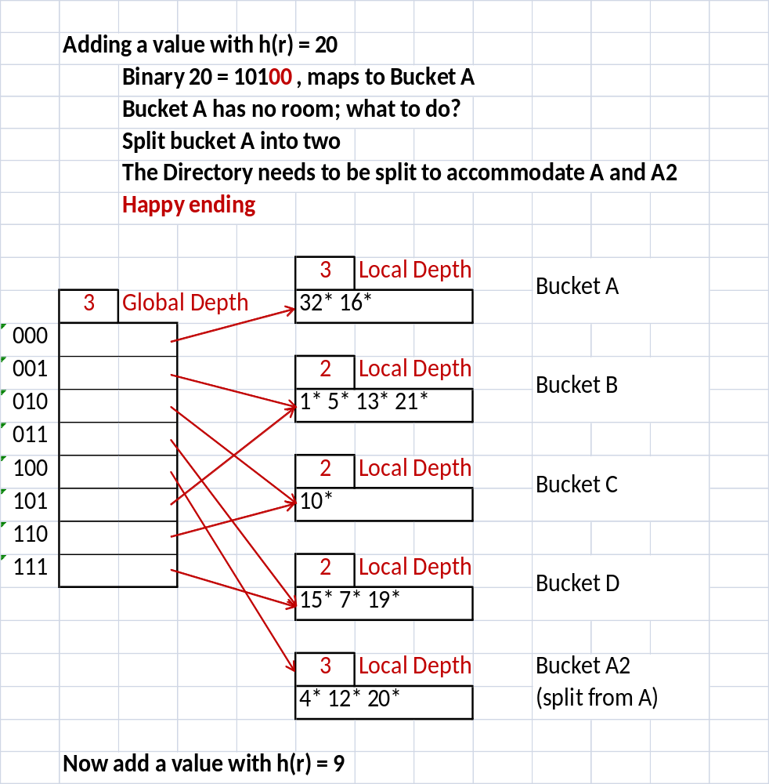
Inserting Key 20
1- Increment the global depth
2- This means ➔ double its size
3- For the overflow bucket, divide
into two
4- Increment their local depth
5- Re-distribute the keys
6- For all other buckets, leave them
as is
7- the number of incoming pointers
to each of these bucket is doubled
For Buckets A & A2 ➔ Keys are distributed based on 3 bits
For Others ➔ Keys are distributed based on 2 bits

Slide 20
Inserting Key 9
Key 9 ➔ 1001 (global depth = 3)
Key 9 ➔ Bucket B (Full) ☹
Since local depth < global depth
  No need to double
  Only split the bucket
  Increment local depth
  Re-distribute its keys

Slide 21
Inserting Key 9
3
1, 9
X
3
5, 13, 21

Slide 22
Extensible Hash Index Summary
Lookup:
  Global depth: # of bits needed to tell which bucket a datum belongs
  Search the bucket
Insertion:
  If a bucket has room, add the hash key
  If no room,
    May be able to add a new page without doubling (E.g., when adding 9*)
    May need to double the directory (E.g., when adding 20*)
  How to tell if doubling is necessary?
    Doubling is necessary if Global Depth = Local Depth of overflow bucket
Notes:
6

